Slide 1
Physics 4 – Feb 2, 2020
Do now – Sketch the nuclear model of the atom from what you remember from chemistry. Indicate the charge, relative mass and location of protons, neutrons and electrons.
Objective:
Atomic Structure
Assignment: p283 #1-5 and worksheet
Phet Simulation for weekend homework
Agenda:
Review EM Radiation
Emission spectra
Bohr Model of the Atom
Rydberg Equation
Energy Levels in the atom
Bohr model
Quantum mechanical model
Emission and Absorption spectra
PhET simulation (time permitting)

Slide 2
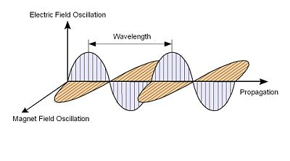
Electromagnetic Radiation
Electromagnetic radiation consists of mutually perpendicular alternating magnetic and electric fields traveling in phase with a specific frequency and wavelength.
All electromagnetic radiation travels at the same velocity: the speed of light
c = 3.00 × 10⁸ m/s.
Therefore, c = λf
λ = wavelength
f = frequency

Slide 3
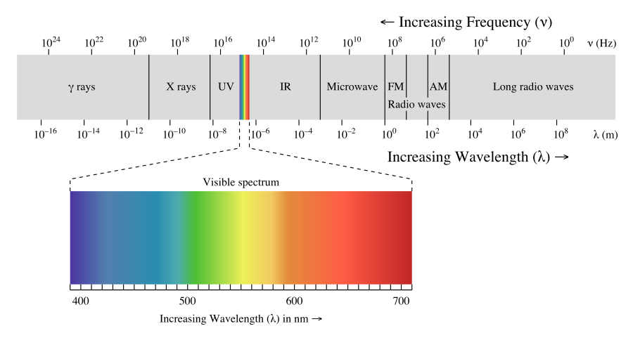
The Nature of Light
Light is both a wave and a particle, and may demonstrate either nature depending on context. (Review from our waves unit)
If one knows the wavelength or frequency of light, one can calculate the energy in one photon, or packet, of that light:
c = λf c = 3.0 x 10⁸ m/s
E = hf = hc/λ h = 6.626 × 10⁻³⁴ J-s
What is the energy of a single photon of light with a wavelength of 575 nm?
What is the wavelength of light that has photons that each have an energy of 3.72 x 10⁻¹⁵ J? What type of electromagnetic radiation is this?

Slide 4
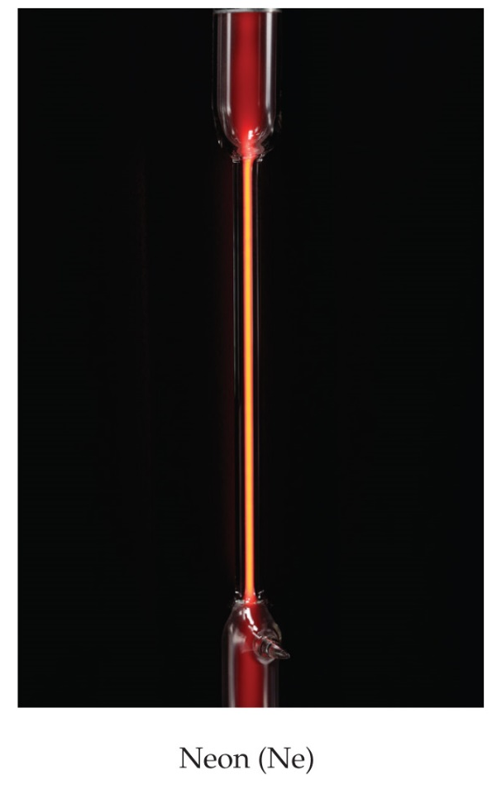
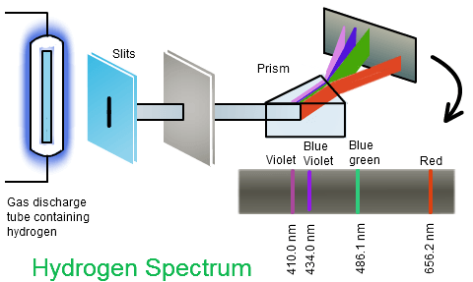
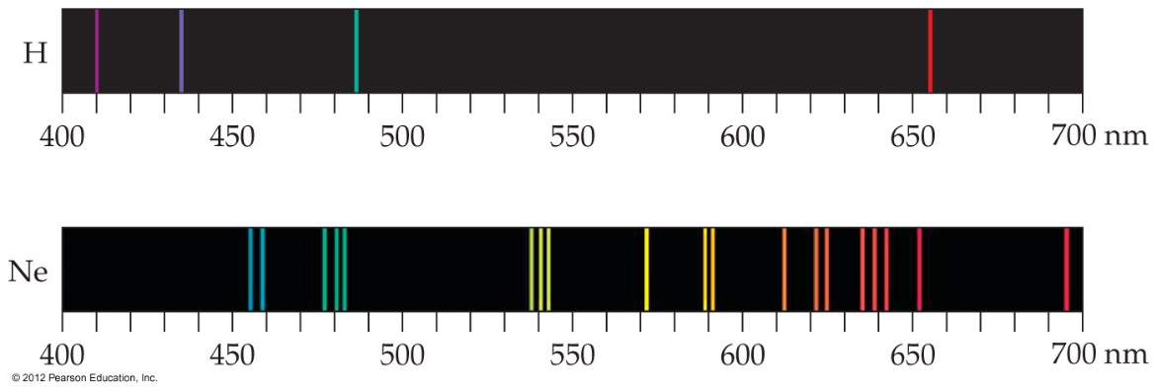
Atomic Emission Spectra
A mystery in the early twentieth century involved the emission spectra observed from energy emitted by atoms and molecules.
For gas samples of atoms and molecules, one does not observe a continuous spectrum, as one gets from a white light source.
Only a line spectrum of discrete wavelengths is observed.
He, Ne, Ar, Kr, Xe gas discharge tube demonstration

Slide 6
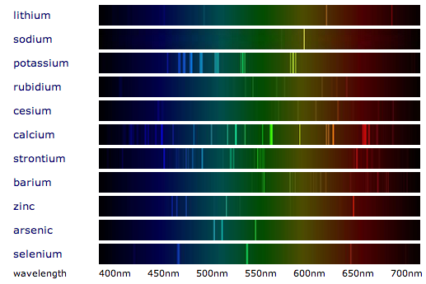
Some other line spectra

Slide 7
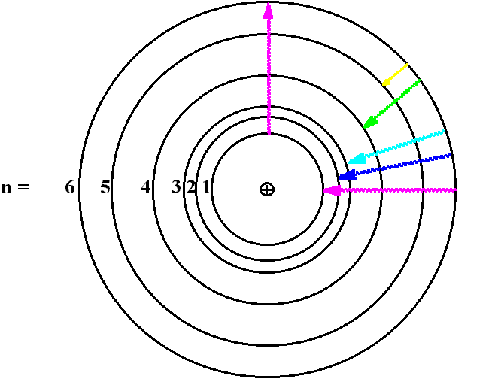
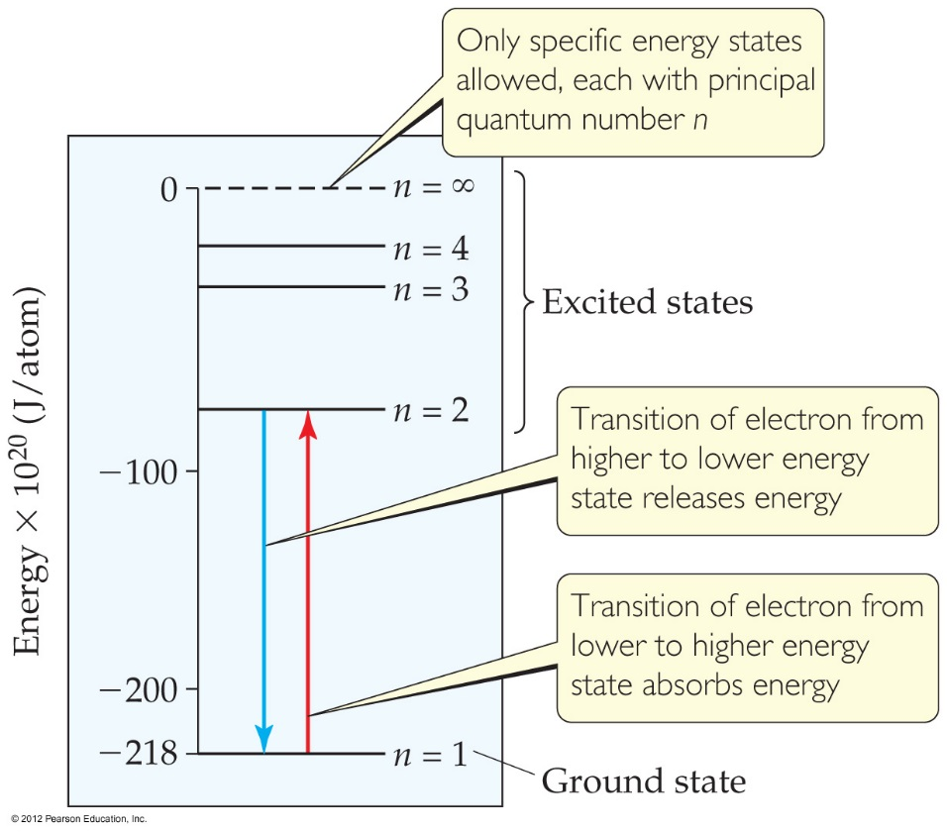
Bohr Model of the Atom
Niels Bohr explained atomic spectra in this way:
1. Electrons in an atom can only occupy certain orbits corresponding to discrete energies.
2. Energy is only absorbed or emitted in such a way as to move an electron from one “allowed” energy state to another; the energy is released as a single photon with
E = hf
(Note: the ground state (n=1) and excited states)
Bohr did not have an explanation for why some energies should be allowed and other not.

Slide 8
Waves explains quantization
The wave nature of matter that is expressed in quantum mechanics explains why some energy levels are allowed and others are not.
HOW??
Recall the pattern of allowed frequencies that exhibit standing waves. They are governed by the mode number, n.
If you fit standing wave patterns within a circular orbit, a natural quantization occurs.
Shown here are the n=2, n=3 and n=4 visualizations of this process using a simple wave form.

Slide 9
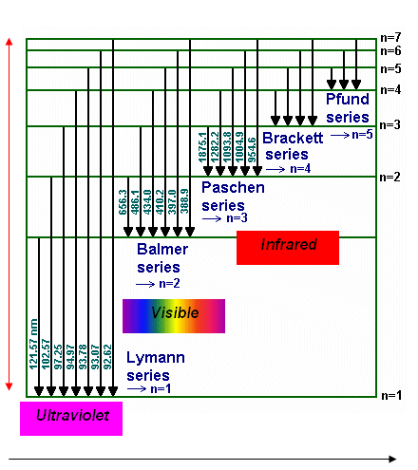
Rydberg/Bohr Equation
1
n_{f}²
1
n_{i}²
1
●
( )
= R_{H}
-
The energy absorbed (+) or emitted (-) from the process of electron promotion or demotion can be calculated by the equation:
1
n_{f}²
1
n_{i}²
( )
ΔE = −hcR_{H}
-
where R_{H} is the Rydberg constant, 1.097 × 10⁷ m⁻¹, and n_{i} and n_{f} are the initial and final energy levels of the electron.
c = 3.0 x 10⁸ m/s h = 6.626 × 10⁻³⁴ J-s
(Test some transitions for agreement.)
– hcR_{H} = – 2.18 x 10⁻¹⁸ J  =
hc
ΔE

Slide 10
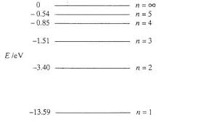
Energy Levels of the H atom
The electron of the H atom as no energy when it is infinitely far from the H nucleus.
The energy of a n=1 electron is – 13.6 eV.
All other energy levels are given by
$E_{n}=−13.6 eV \frac{1}{n^{2}}$
As a result energy levels get closer and closer together in energy, and the separations are given by the Rydberg equation.

Slide 11
Wavefunction s orbitals → Energy levels
The same energy levels for are predicted by the quantum mechanical model.
The y- axis is the opposite of the energy. 4r²(-²)
Notice the relative spacing of the peaks as the n value increases.
Recall that for waves, energy is the square of the amplitude.
Because the results are the same we are free to perform calculations using the simpler Bohr model.

Slide 12
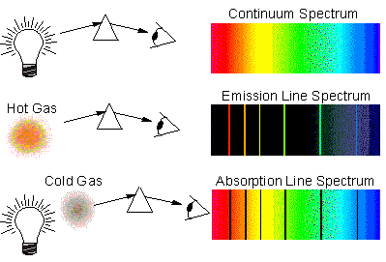
Emission and Absorption spectra
Transition of an electron up to a higher level it is an excitation.
Transition of an electron down to a lower level it is a relaxation.
In an emission spectrum, electrons are excited by electricity and then relax releasing a photon.
If you look at a light source through a gas, the same wavelengths as seen in the emission spectrum will be darkened.
In an absorption spectrum, electrons are excited by a photon and release a photon. We see the dark lines because the light gets scattered.
This is how we know the
elemental composition of stars!!

Slide 13
Possible transitions
Light must be of a specific wavelength to interact with an atom. Otherwise it will pass right through.
A particle at any speed can hit an atom and excite an electron to a higher energy level, leaving with any excess kinetic energy.
An excited electron may relax all the way down to the ground state in a one step process.
OR may transition first to a lower excited state and then down to the ground state in a two step process.
https://phet.colorado.edu/en/simulation/legacy/discharge-lamps

Slide 14
Exit slip and homework
Exit Slip – A) What energy is associated with an electron moving to a different level releasing a photon with a wavelength of 1282.2 nm?
B) Which part of the hydrogen atom spectrum is this part of?
C) What quantum levels are involved in the transition?
What’s due? (homework for a homework check next class)
Hydrogen Atom Worksheet and textbook problems
Homework Project due Tuesday: Atomic Structure Phet Simulation
What’s next? (What to read to prepare for the next class)
Read Ch 7.1 Discrete energy and radioactivity p270 – 281

